Slide 1
14.4 Classification Trees

Slide 2
Classification Stumps

Slide 3
For the same practical reasons described for regression we cannot use local optimization to determine an optimal choice for all parameters of a classification stump simultaneously.
Instead we must again test out a variety of choices - different stumps consisting of different split-points and leaf values - in search of the ideal.
Because the output of classification data is *discrete*, instead of assigning leaf values based on the *mean of the output* on either side of a split point, which can create numerical values that do not belong to either class, we can assign leaf values based on the *mode of the output* (the *majority vote*).

Slide 4
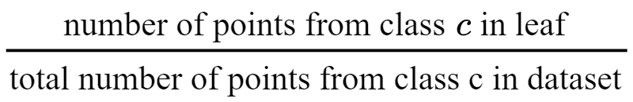
Using the *mode* as opposed to the *mean* would keep our leaf values constrained to discrete labels of our data, providing more appropriate stumps.
To compensate for potential class imbalances in a particular leaf, a *balanced majority vote* is typically used that weights each 'vote' in determining a leaf's value by the fraction of total dataset belonging to each class.
This means that instead of setting a leaf value to the most *common* label value it contains, we compute the fraction for each class, and assign the leaf the label value c with the largest fraction.

Slide 5
In order to determine an optimal split point we can employ a two-class accuracy metric like *balanced accuracy*.
In the context of classification trees accuracy metrics are often called *purity* metrics, since they measure how *pure* each leaf of the stump is in terms of class representation.
As with regression stumps, with large datasets a range of efficiency shortcuts may be taken in practice to limit the number of stumps tested including coarser selections of split-points, testing only a random subset of input dimensions, etc.

Slide 6
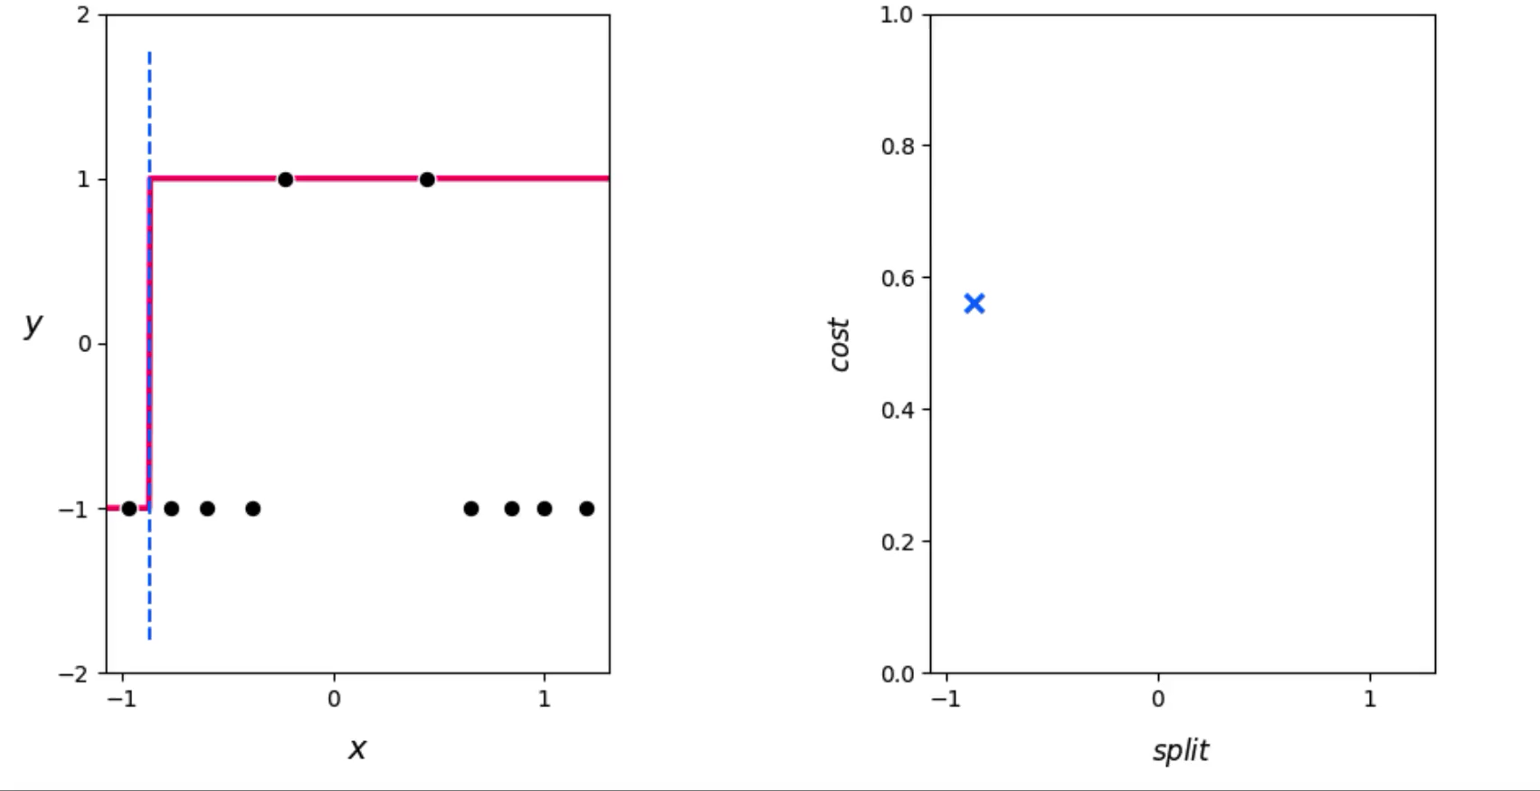

Slide 7
Classification Trees of Maximum Depth

Slide 8
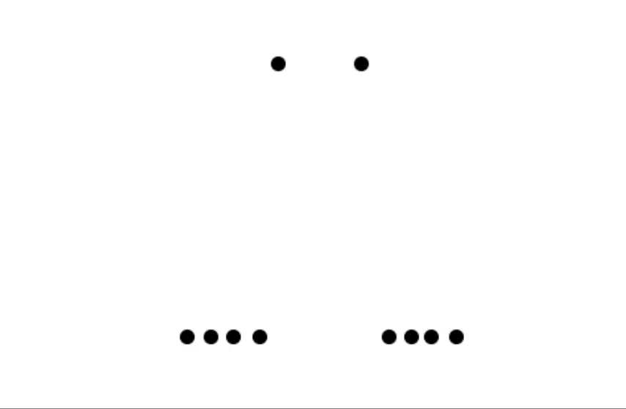

Slide 9
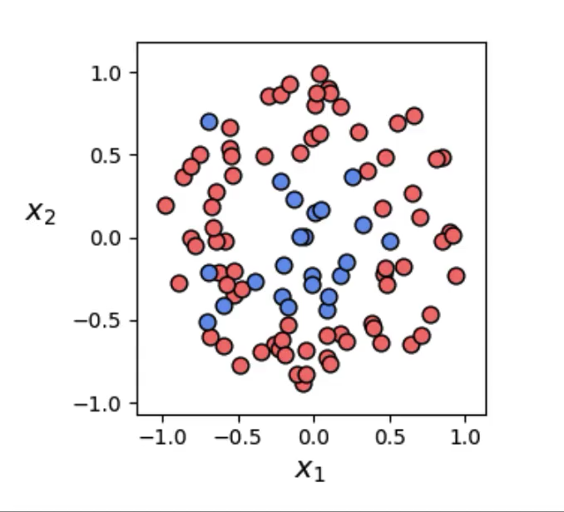

Slide 10
